Slide 1
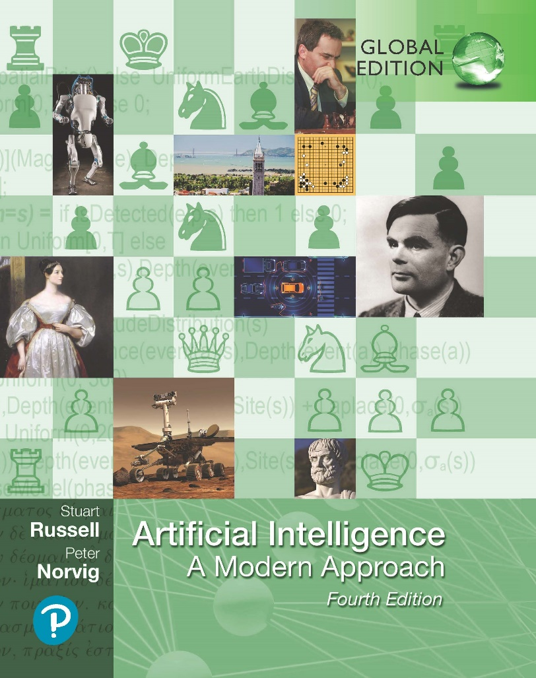
Artificial Intelligence: A Modern Approach
Fourth Edition, Global Edition
Chapter 27
Computer Vision
© 2022 Pearson Education Ltd.

Slide 2
Outline
Introduction
Image Formation
Simple Image Features
Classifying Images
Detecting Objects
The 3D World
Using Computer Vision

Slide 3
Introduction
Most agents that use vision use passive sensing
A feature is a number obtained by applying simple computations to an image.
The model-based approach to vision uses two kinds of models
object model
Example: precise geometric model produced by computer aided design systems
rendering model
Describes the physical, geometric, and statistical processes that produce the stimulus from the world
two core problems of computer vision are
reconstruction, where an agent builds a model of the world from an image or a set of images,
recognition, where an agent draws distinctions among the objects it encounters based on visual and other information

Slide 4
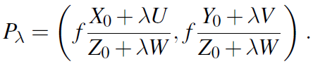
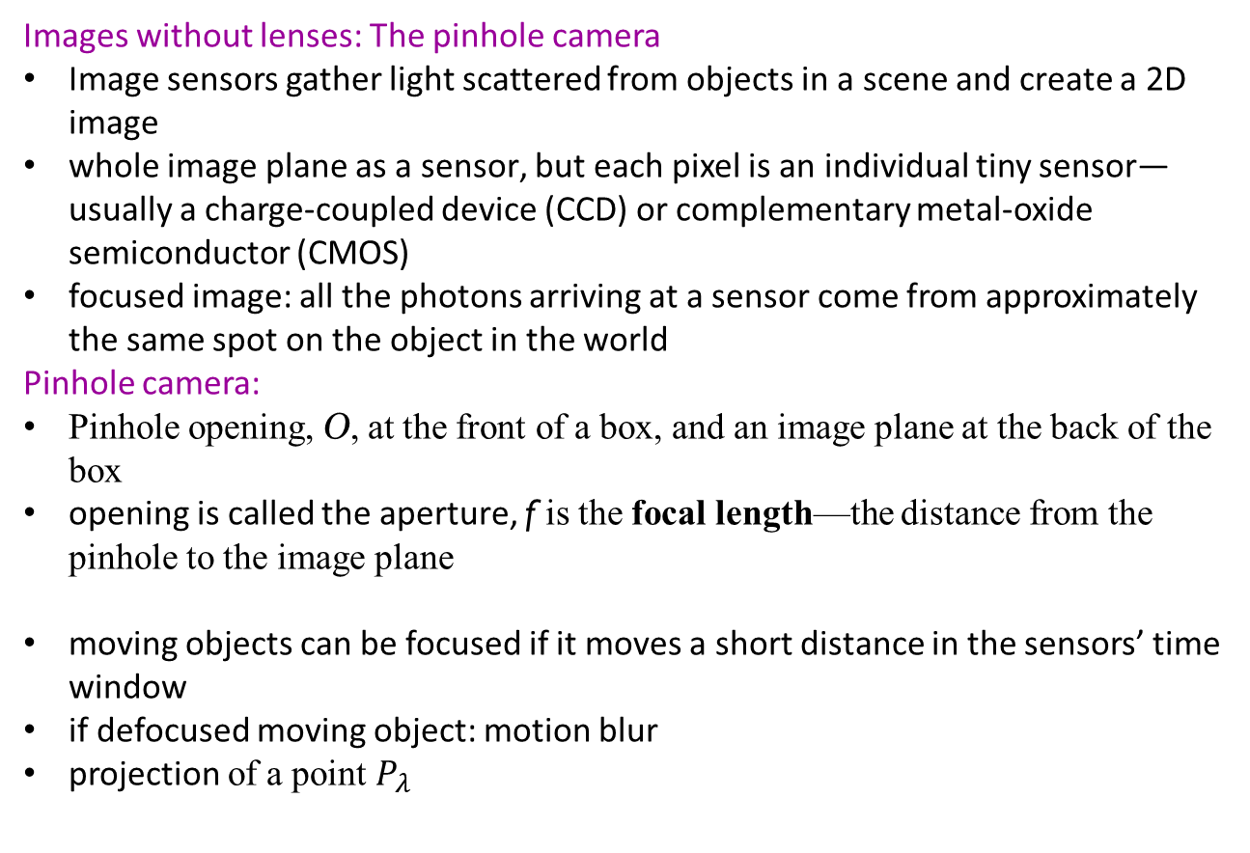
Image Formation
Images without lenses: The pinhole camera
Image sensors gather light scattered from objects in a scene and create a 2D image
whole image plane as a sensor, but each pixel is an individual tiny sensor—usually a charge-coupled device (CCD) or complementary metal-oxide semiconductor (CMOS)
focused image: all the photons arriving at a sensor come from approximately the same spot on the object in the world
Pinhole camera:
Pinhole opening, O, at the front of a box, and an image plane at the back of the box
opening is called the aperture, f is the focal length—the distance from the pinhole to the image plane
moving objects can be focused if it moves a short distance in the sensors’ time window
if defocused moving object: motion blur
projection of a point $P_{λ}$

Slide 5
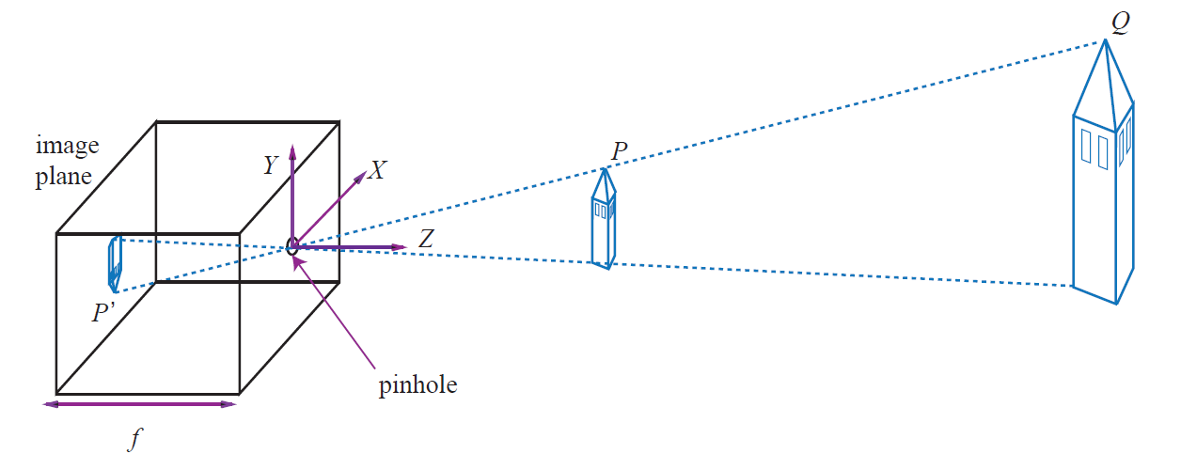
Image Formation
Each light sensitive element at the back of a pinhole camera receives light that passes through the pinhole from a small range of directions. If the pinhole is small enough, the result is a focused image behind the pinhole. The process of projection means that large, distant objects look the same as smaller, nearby objects—the point P^{t} in the image plane could have come from a nearby toy tower at point P or from a distant real tower at point Q.

Slide 6
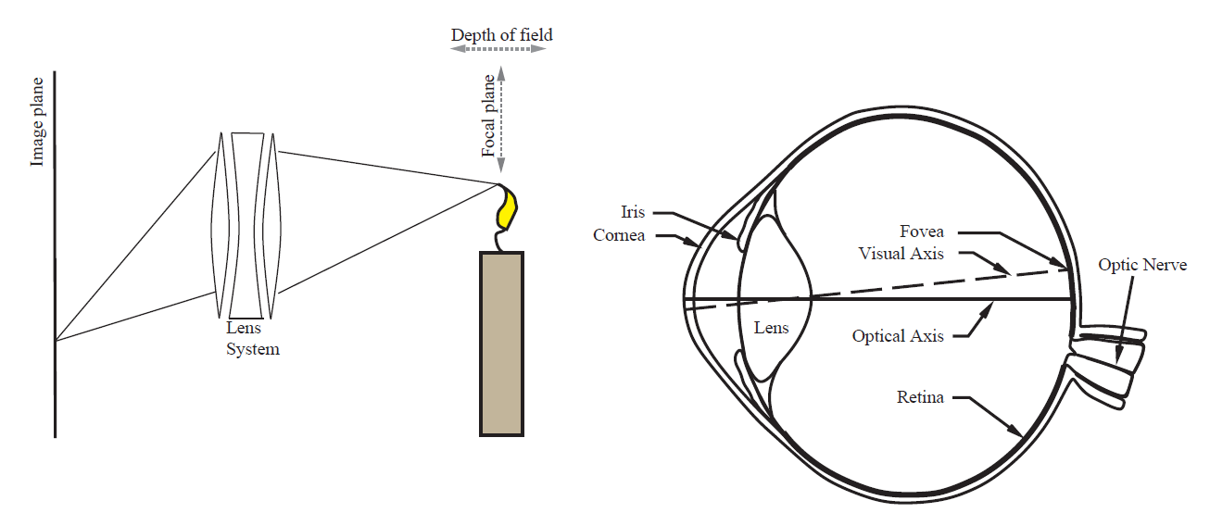
Image Formation
Lens systems
Lens design restricts them to focusing light only from points that lie within a range of Z depths from the lens.
The center of this range—where focus is sharpest—is called the focal plan
The range of depths for which focus remains sharp enough is called the depth of field.
The larger the lens aperture (opening), the smaller the depth of field.

Slide 7
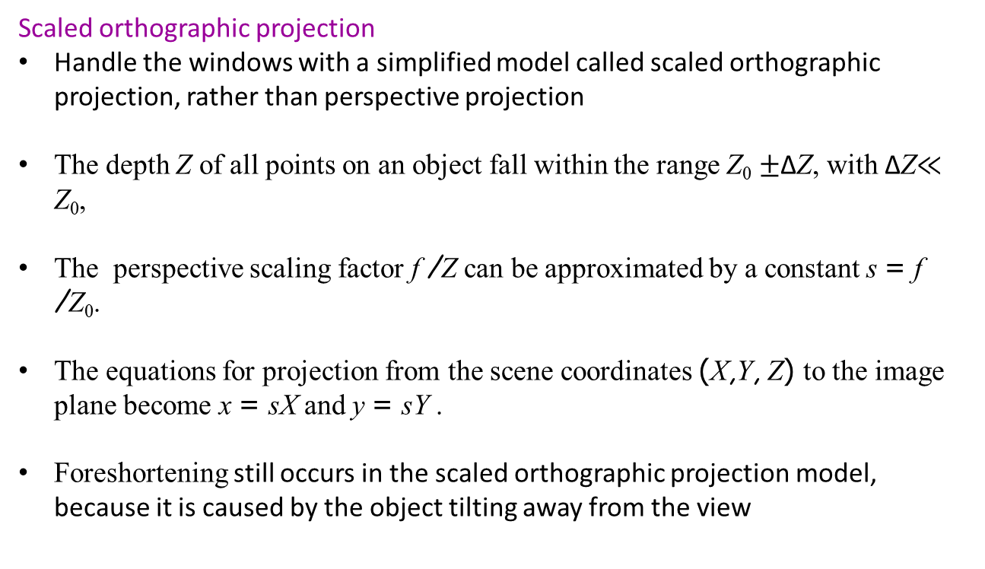
Image Formation
Scaled orthographic projection
Handle the windows with a simplified model called scaled orthographic projection, rather than perspective projection
The depth Z of all points on an object fall within the range Z₀ $±$∆Z, with ∆Z$≪$ Z₀,
The perspective scaling factor f /Z can be approximated by a constant s = f /Z₀.
The equations for projection from the scene coordinates (X,Y, Z) to the image plane become x = sX and y = sY .
Foreshortening still occurs in the scaled orthographic projection model, because it is caused by the object tilting away from the view

Slide 8
Image Formation
Light and shading
The brightness of a pixel in the image is a function of the brightness of the surface patch in the scene that projects to the pixel
The ambiguity occurs because there are three factors that contribute to the amount of light:
the overall intensity of ambient light;
whether the point is facing the light or is in shadow); and
the amount of light reflected from the point.
Diffuse reflection scatters light evenly across the directions leaving a surface, so the brightness of a diffuse surface doesn’t depend on the viewing direction
Specular reflection causes incoming light to leave a surface in a lobe of directions that is determined by the direction the light arrived from
Illumination rays all travel parallel to one another in a known direction
model this behavior with a distant point light source
If the surface cannot see the source, then it is in shadow

Slide 9
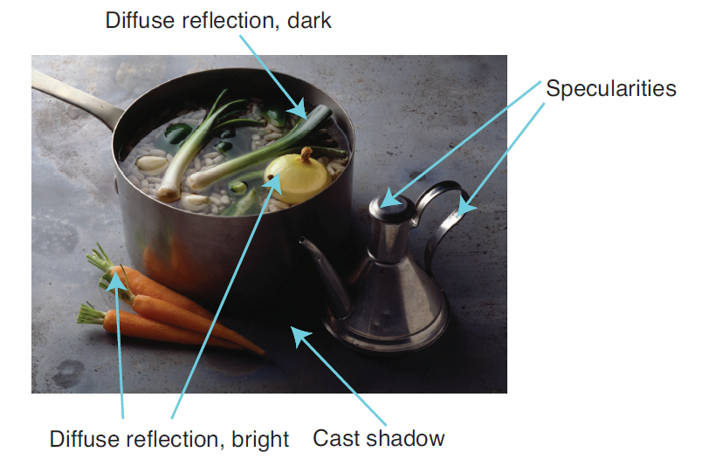
Image Formation
This photograph illustrates a variety of illumination effects. There are specularities on the stainless steel cruet. The onions and carrots are bright diffuse surfaces because they face the light direction. The shadows appear at surface points that cannot see the light source at all. Inside the pot are some dark diffuse surfaces where the light strikes at a tangential angle. (There are also some shadows inside the pot.)

Slide 10
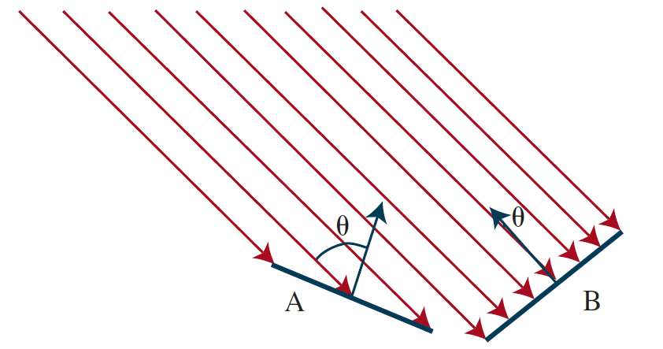
Image Formation
Two surface patches are illuminated by a distant point source, whose rays are shown as light arrows. Patch A is tilted away from the source (θ is close to 90◦) and collects less energy, because it cuts fewer light rays per unit surface area. Patch B, facing the source (θ is close to 0◦), collects more energy.

Slide 11
Image Formation
Color
Principle of trichromacy
match the visual appearance of any spectral energy density, however complex, by mixing appropriate amounts of just three primaries.
Three primaries
no mixture of any two will match the third.
red primary, one green, and one blue, abbreviated as RGB
Color constancy
estimate the color the surface would have under white light
Ignore the effects of different colored lights

Slide 12
Simple Image Features
Edges
Edges are straight lines or curves in the image plane across which there is a “significant” change in image brightness.
Edge detection: abstract away from the messy, multi-megabyte image and towards a more compact, abstract representation
Effects in the scene very often result in large changes in image intensity producing edges
Depth discontinuities can cause edges
the surface normal changes
surface reflectance
shadow is a discontinuity in illumination
Finding edges requires care
Intensity difference alone can give mistakes in identifying edges due to noise.
Noise: changes to the value of a pixel that don’t have to do with an edge.

Slide 13
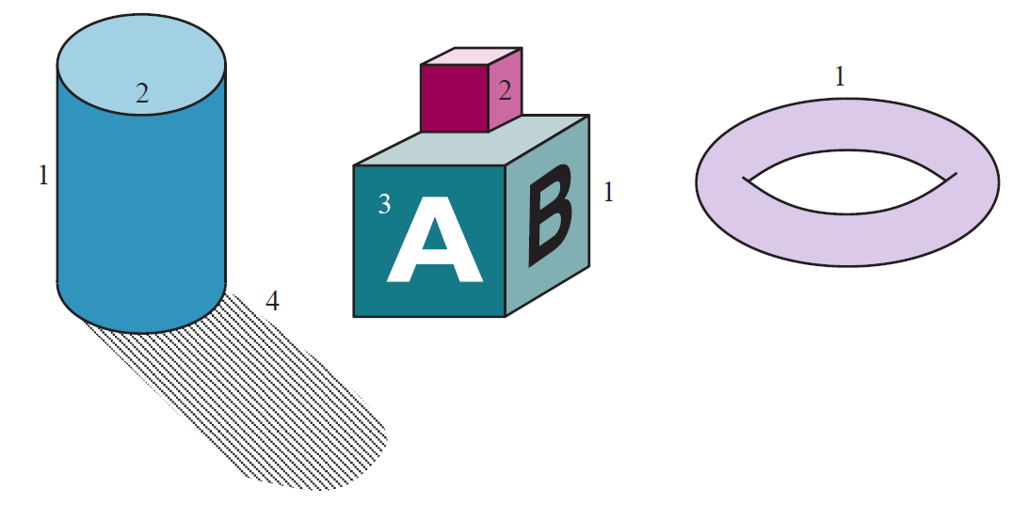
Simple Image Features
Different kinds of edges: (1) depth discontinuities; (2) surface orientation discontinuities; (3) reflectance discontinuities; (4) illumination discontinuities (shadows).

Slide 14
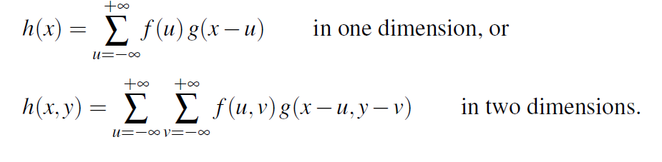
Simple Image Features
Smoothing involves using surrounding pixels to suppress noise
Predict value of pixel as a weighted sum of nearby pixels (more weight for closest)
Gaussian filter: the convolution of two functions f and g (denoted as h = f ∗ g)
Applying a Gaussian filter means replacing the intensity I(x₀, y₀) with the sum, over all (x, y) pixels, of I(x, y) G_{σ}(d), where d is the distance from (x₀, y₀) to (x, y).

Slide 15
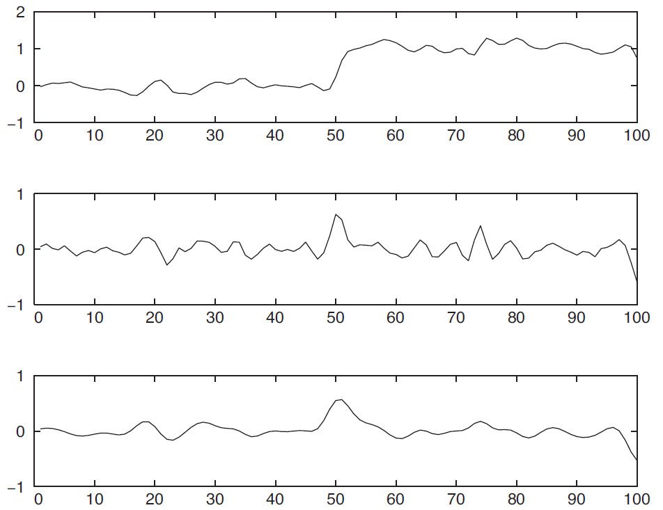
Simple Image Features
Top: Intensity profile I(x) along a one-dimensional section across a step edge. Middle: The derivative of intensity, I!(x). Large values of this function correspond to edges, but the function is noisy. Bottom: The derivative of a smoothed version of the intensity. The noisy candidate edge at x = 75 has disappeared.

Slide 16
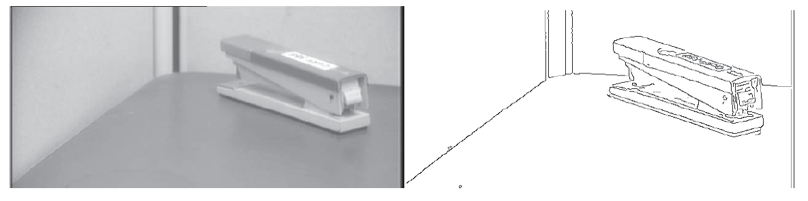
Simple Image Features
Photograph of a stapler. (b) Edges computed from (a).
The output is not perfect: there are gaps where no edge appears, and there are “noise” edges that do not correspond to anything of significance in the scene. Later stages of processing will have to correct for these errors

Slide 17
Simple Image Features
Texture
texture refers to a pattern on a surface that can be sensed visually
usual rough model of texture is a repetitive pattern of elements, sometimes called texels
property of an image patch, rather than a pixel in isolation
no change when the lighting changes
change in a sensible way when the patch rotates.
useful for identifying objects and matching patches
basic construction for a texture representation
compute the gradient orientation at each pixel in the patch
characterize the patch by a histogram of orientations

Slide 18
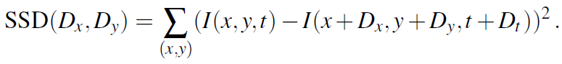
Simple Image Features
Optical flow
Optical flow: apparent motion whenever there is relative movement between the camera and one or more objects in the scene
describes the direction and speed of motion of features in the image as a result of relative motion between the viewer and the scene.
measure of similarity, sum of squared differences (SSD):
Here, (x, y) ranges over pixels in the block centered at (x₀, y₀). We find the (D_{x}, D_{y}) that minimizes the SSD. The optical flow at (x₀, y₀) is then (v_{x}, v_{y}) = (D_{x}/D_{t}, D_{y}/D_{t}).
Requires some texture in the scene, resulting in windows containing a significant variation in brightness among the pixels

Slide 19
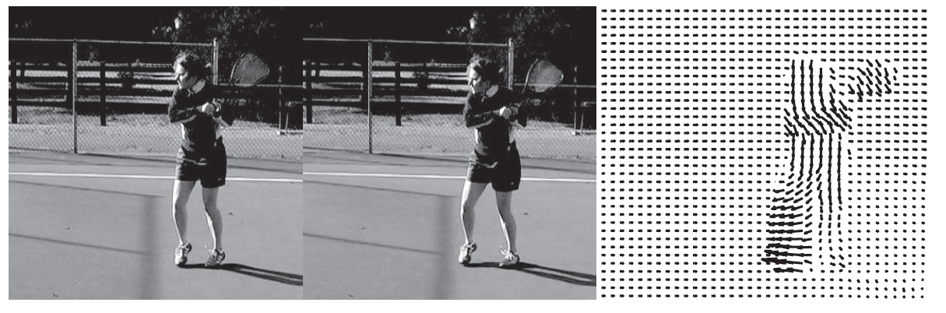
Simple Image Features
Two frames of a video sequence and the optical flow field corresponding to the displacement from one frame to the other. Note how the movement of the tennis racket and the front leg is captured by the directions of the arrows.

Slide 20
Simple Image Features
Segmentation of natural images
Segmentation is the process of breaking an image into groups of similar pixels.
Focus: detecting the boundaries or group themselves (regions)
Classification problem
boundary curve at pixel location (x, y), an orientation θ. An image neighborhood centered at (x, y) looks roughly like a disk, cut into two halves by a diameter oriented at θ.
compute the probability P_{b}(x, y, θ) that there is a boundary curve at that pixel along that orientation by comparing features in the two halves.
to train a machine learning classifier using a data set of natural images in which humans have marked the ground truth boundaries
the goal of the classifier is to mark exactly those boundaries marked by humans and no other
alternative approach is based on trying to “cluster” the pixels

Slide 21
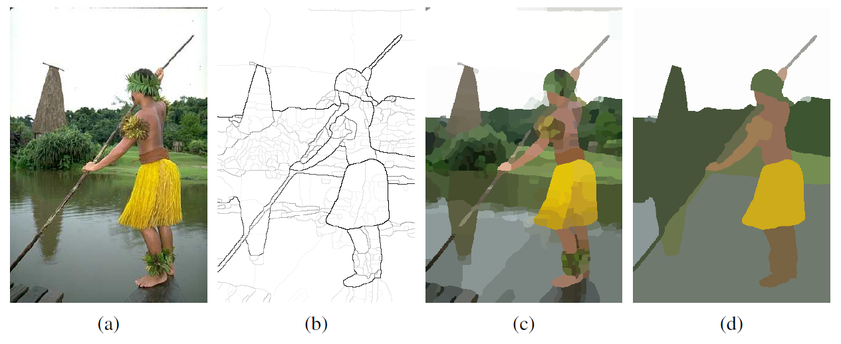
Simple Image Features
Original image.
Boundary contours, where the higher the P_{b} value, the darker the contour.
Segmentation into regions, corresponding to a fine partition of the image. Regions are rendered in their mean colors.
Segmentation into regions, corresponding to a coarser partition of the image, resulting in fewer regions.

Slide 22
Classifying Images
Modern systems classify images using appearance (i.e., color and texture, as opposed to geometry)
There are two difficulties
different instances of the same class could look different—some cats (black and orange)
Look different at different times depending on several effects
Lighting
Foreshortening
Aspect
Occlusion
Deformation
Deal with these problems by learning representations and classifiers from
very large quantities of training data using a convolutional neural network.

Slide 23
Classifying Images
Image classification with convolutional neural networks (CNN)
With enough training data and enough training ingenuity, CNNs produce very successful classification systems
Images can have small alterations without changing the identity
local patterns can be quite informative.
spatial relations between local patterns are informative
Convolution followed by a ReLU activation function—as a local pattern detector
convolution measures how much each local window of the image looks like the kernel pattern
ReLU sets low-scoring windows to zero, and emphasizes high-scoring window
convolution with multiple kernels finds multiple patterns
composite patterns can be detected by applying another layer to the output of the first layer.

Slide 24
Classifying Images
Data set augmentation: training examples are copied and modified slightly Images can have small alterations without changing the identity
randomly shift, rotate,or stretch an image by a small amount, or randomly shift the hue of the pixels by a small amount local patterns
CNN-based classifiers are good at ignoring patterns that aren’t discriminative
Context: patterns that lie off the object might be discriminative
e.g., a cat toy, a collar with a little bell, or a dish of cat food might actually help tell that we are looking at a cat

Slide 25
Detecting Objects
Object detectors find multiple objects in an image, report what class each object is and also report where each object is by giving a bounding box around the object
Building an object detector:
looking at a small sliding window onto the larger image—a rectangle.
At each spot, we classify what we see in the window, using a CNN classifier
Details:
Decide on a window shape
Build a classifier for windows
Decide which windows to look at
Choose which windows to report
Report precise locations of objects using these windows
A network that finds regions with objects is called a regional proposal network (RPN)
Faster RCNN encodes a large collection of bounding boxes as a map of fixed size

Slide 26
Detecting Objects
construct a 3D block where each spatial location in the block has two dimensions for the center point and one dimension for the type of box
any box with a good enough objectness score is called a region of interest
(ROI)
make them have the same number of features by sampling the pixels to extract features, a process called ROI pooling
greedy algorithm for deciding windows to report called non-maximum suppression: sort based scores over threshold, choose highest score, discared overlapping
bounding box regression: trim the window down to a proper bounding box

Slide 27
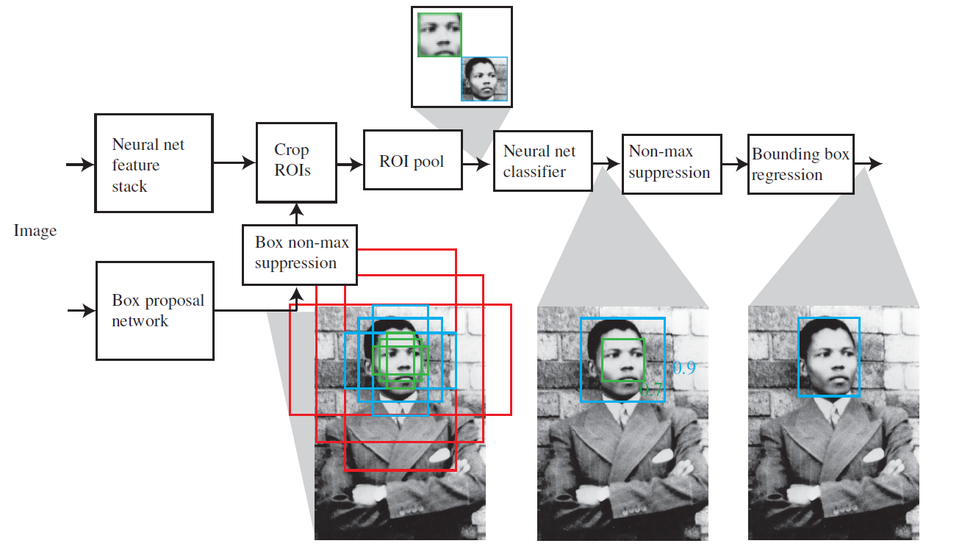
Detecting Objects
Faster RCNN uses two networks
first network computes “objectness” scores of candidate image boxes, called “anchor boxes,” centered at a grid point.
second network is a feature stack that computes a representation of the image suitable for classification

Slide 28
3D World
Two pictures of objects in a 3D world are better than one
two images of the same scene taken from different viewpoints and you know enough about the two cameras
two views of enough points, and you know which point in the first view corresponds to which point in the second view
key problem is to establish which point in the first view corresponds to which in the second view
two ways of getting multiple views of a scene
two cameras
Move

Slide 29
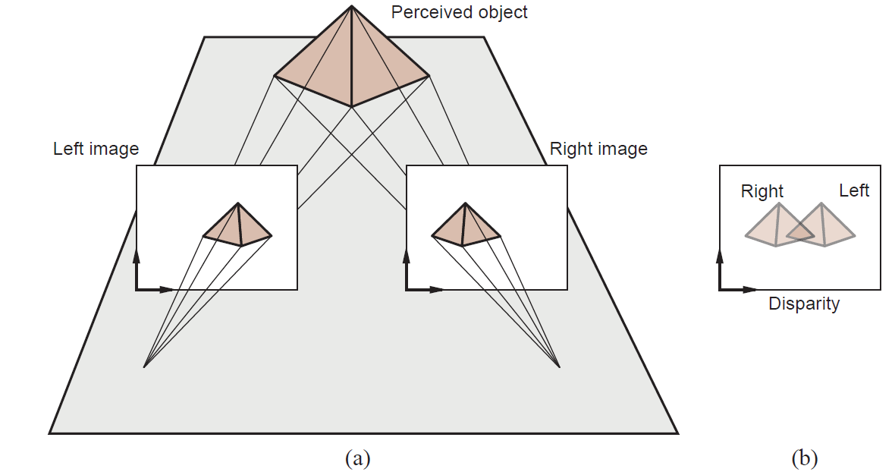
3D World
Translating a camera parallel to the image plane causes image features to move in the camera plane. The disparity in positions that results is a cue to depth. If we superimpose left and right images, as in (b), we see the disparity

Slide 30
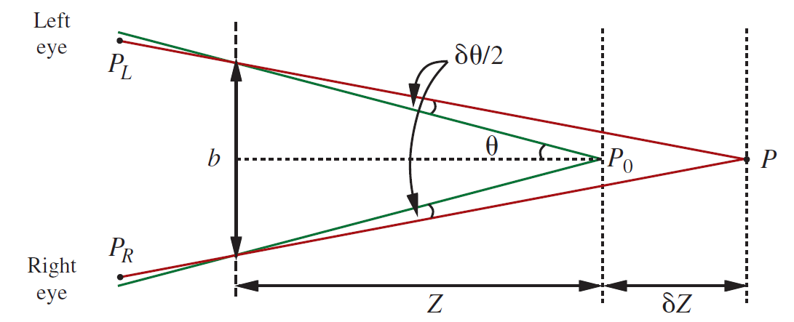
3D World
The relation between disparity and depth in stereopsis. The centers of projection of the two eyes are distance b apart, and the optical axes intersect at the fixation point P₀. The point P in the scene projects to points P_{L} and P_{R} in the two eyes. In angular terms, the disparity between these is δθ (the diagram shows two angles of δθ .

Slide 31
Using Computer Vision
Understanding what people are doing
Difficulty of how to link observations of the body and the objects nearby to the goals and intentions of the moving people.
Another difficulty is caused by time scale. What someone is doing depends quite strongly on the time scale
unrelated behaviors are going on at the same time
Learned classifiers are guaranteed to behave well only if the training and test data come from the same distribution.
For activity data, the relationship between training and test data is more untrustworthy people do so many things in so many context

Slide 32
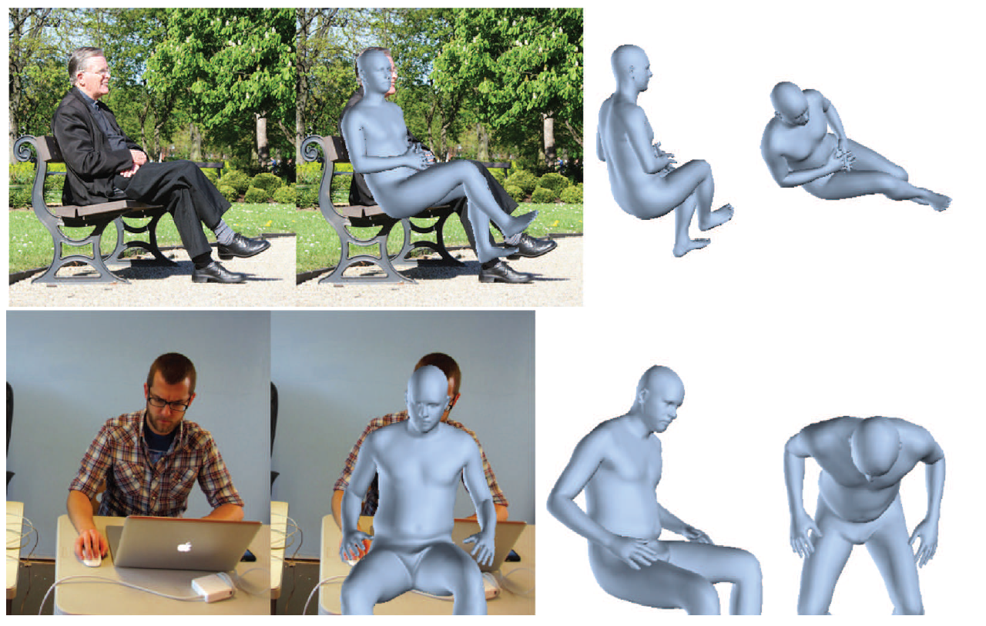
Using Computer Vision
Reconstructing humans from a single image is now practical. Each row shows a reconstruction of 3D body shape obtained using a single image

Slide 33
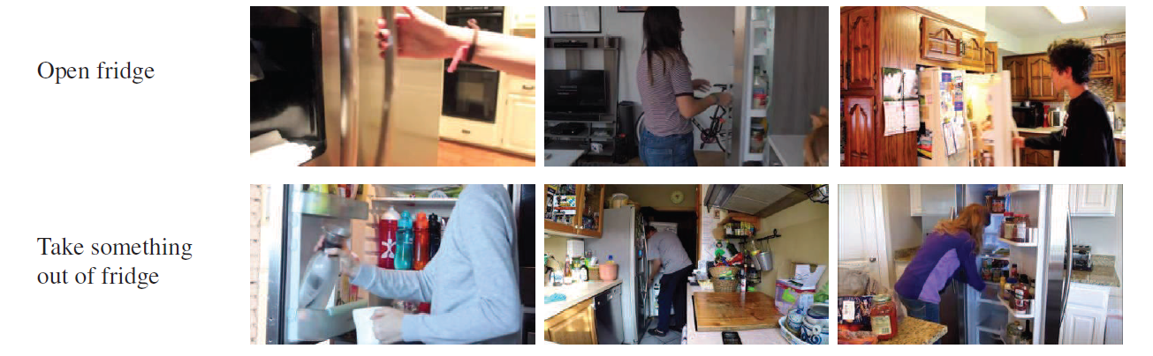
Using Computer Vision
The same action can look very different; and different actions can look similar

Slide 34
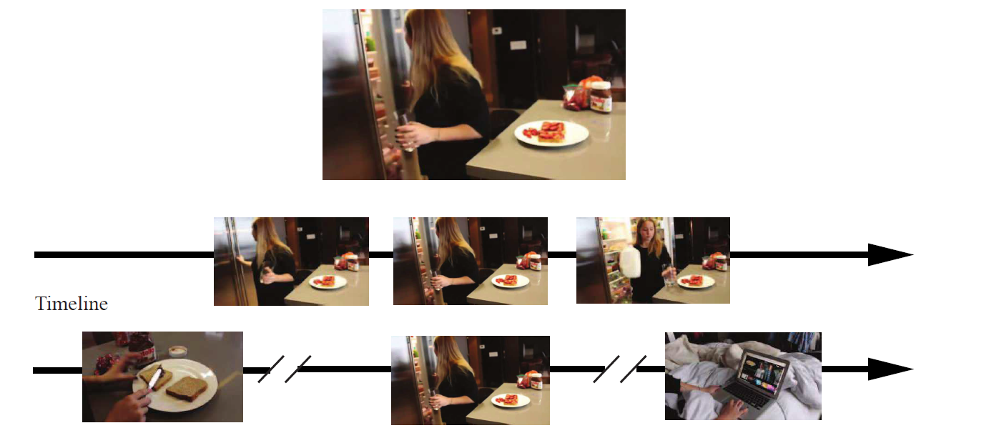
Using Computer Vision
What you call an action depends on the time scale. The single frame at the top is best described as opening the fridge (you don’t gaze at the contents when you close a fridge). But if you look at a short clip of video (indicated by the frames in the center row), the action is best described as getting milk from the fridge. If you look at a long clip (the frames in the bottom row), the action is best described as fixing a snack.

Slide 35
Using Computer Vision
Linking pictures and words
tagging systems that tag images with relevant words.
tags aren’t a comprehensive description of what is happening
in an image
captioning systems—systems that write a caption of one or more sentences describing the image.
Current methods for captioning use detectors to find a set of words that describe the image, and provide those words to a sequence model that is trained to generate a sentence
To establish whether a system has a good representation of what is happening in an image is
visual question answering or VQA system and a visual dialog system

Slide 36
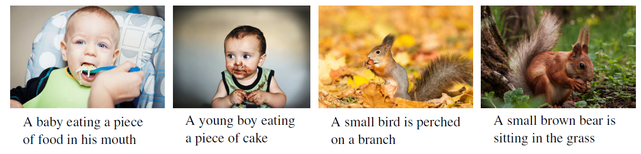
Using Computer Vision
Automated image captioning systems produce some good results and some failures.

Slide 37
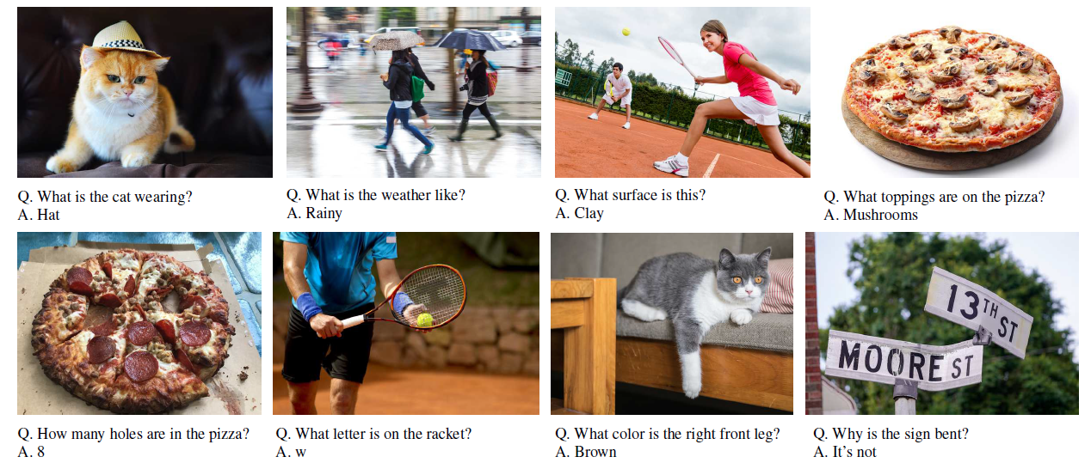
Using Computer Vision
Visual question-answering systems produce answers (typically chosen from a multiple-choice set) to natural-language questions about images

Slide 38
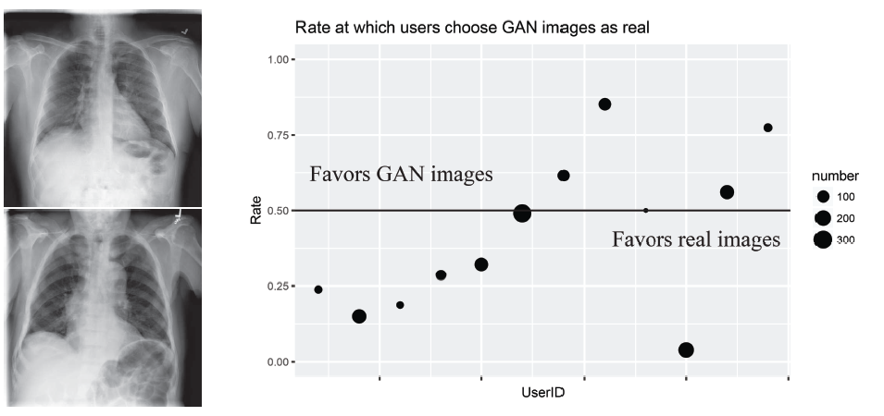
Using Computer Vision
GAN generated images of lung X-rays. results of a test asking radiologists, given
a pair of X-rays as seen on the left, to tell which is the real X-ray

Slide 39
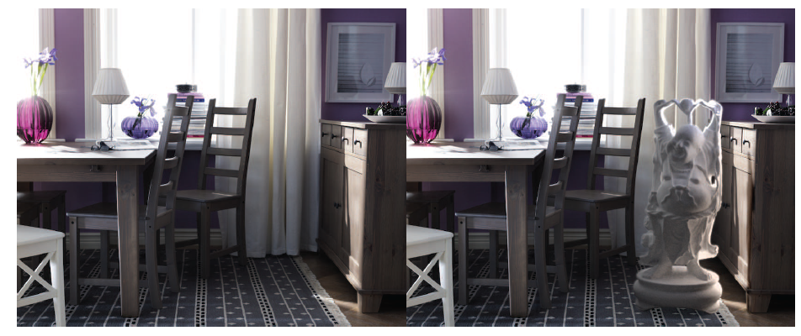
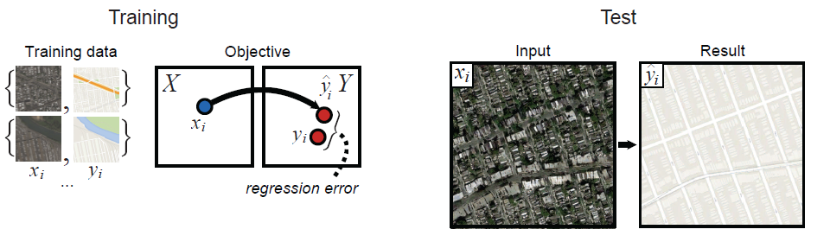
Using Computer Vision
Making pictures

Slide 40
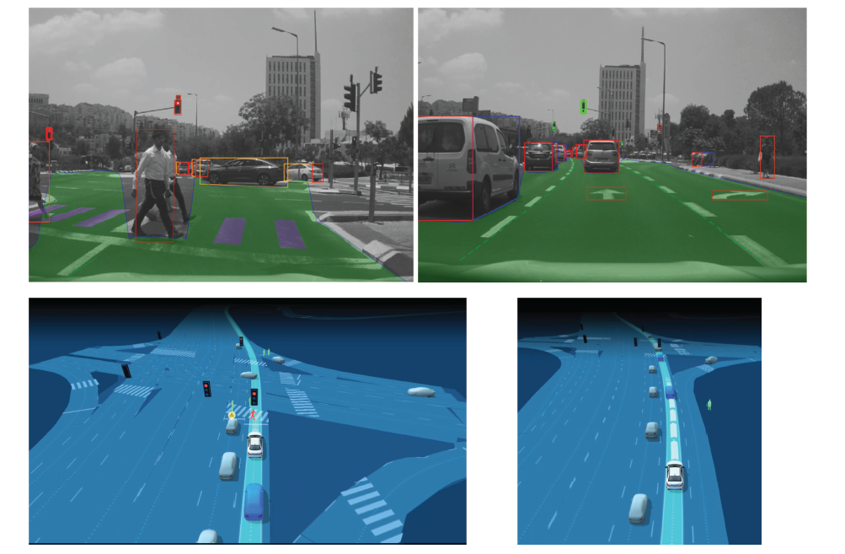
Using Computer Vision
Mobileye’s camera-based sensing for autonomous vehicles

Slide 41
Summary
Representations of images capture edges, texture, optical flow, and regions
Convolutional neural networks produce accurate image classifiers that use learned features.
Image classifiers can be turned into object detectors
With more than one view of a scene, it is possible to recover the 3D structure of the scene and the relationship between views

